Slide 1



Business Insight 360 Power BI
View in Power BI
Last data refresh:
7/18/2026 12:15:37 PM UTC
Downloaded at:
7/18/2026 5:59:18 PM UTC

Slide 2
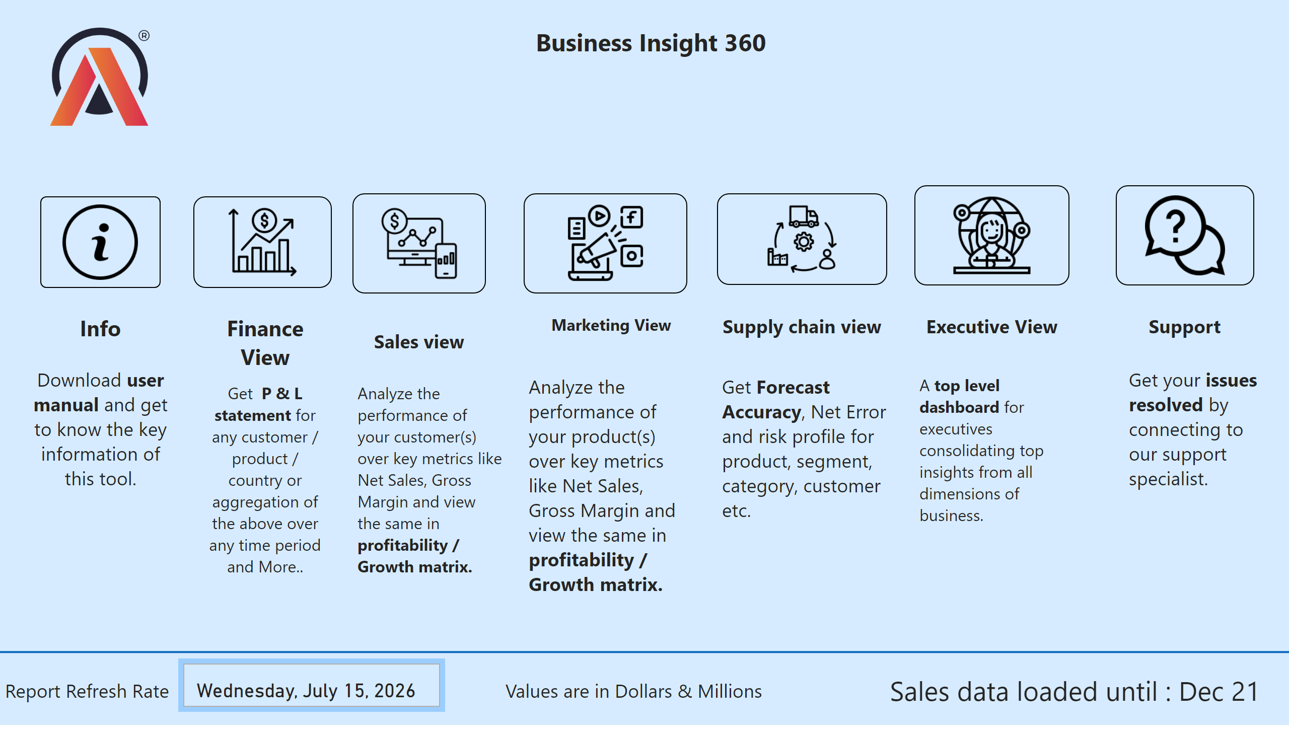
Home
Notes:
image
No alt text provided
image
No alt text provided
textbox
No alt text provided
textbox
No alt text provided
image
No alt text provided
textbox
No alt text provided
textbox
No alt text provided
cardVisual
No alt text provided
textbox
No alt text provided
textbox
No alt text provided
textbox
No alt text provided
textbox
No alt text provided
textbox
No alt text provided
cardVisual
No alt text provided
textbox
No alt text provided
textbox
No alt text provided
image
No alt text provided
textbox
No alt text provided
image
No alt text provided
textbox
No alt text provided
image
No alt text provided
textbox
No alt text provided
shape
No alt text provided
textbox
No alt text provided
image
No alt text provided
textbox
No alt text provided
textbox
No alt text provided
image
No alt text provided

Slide 3
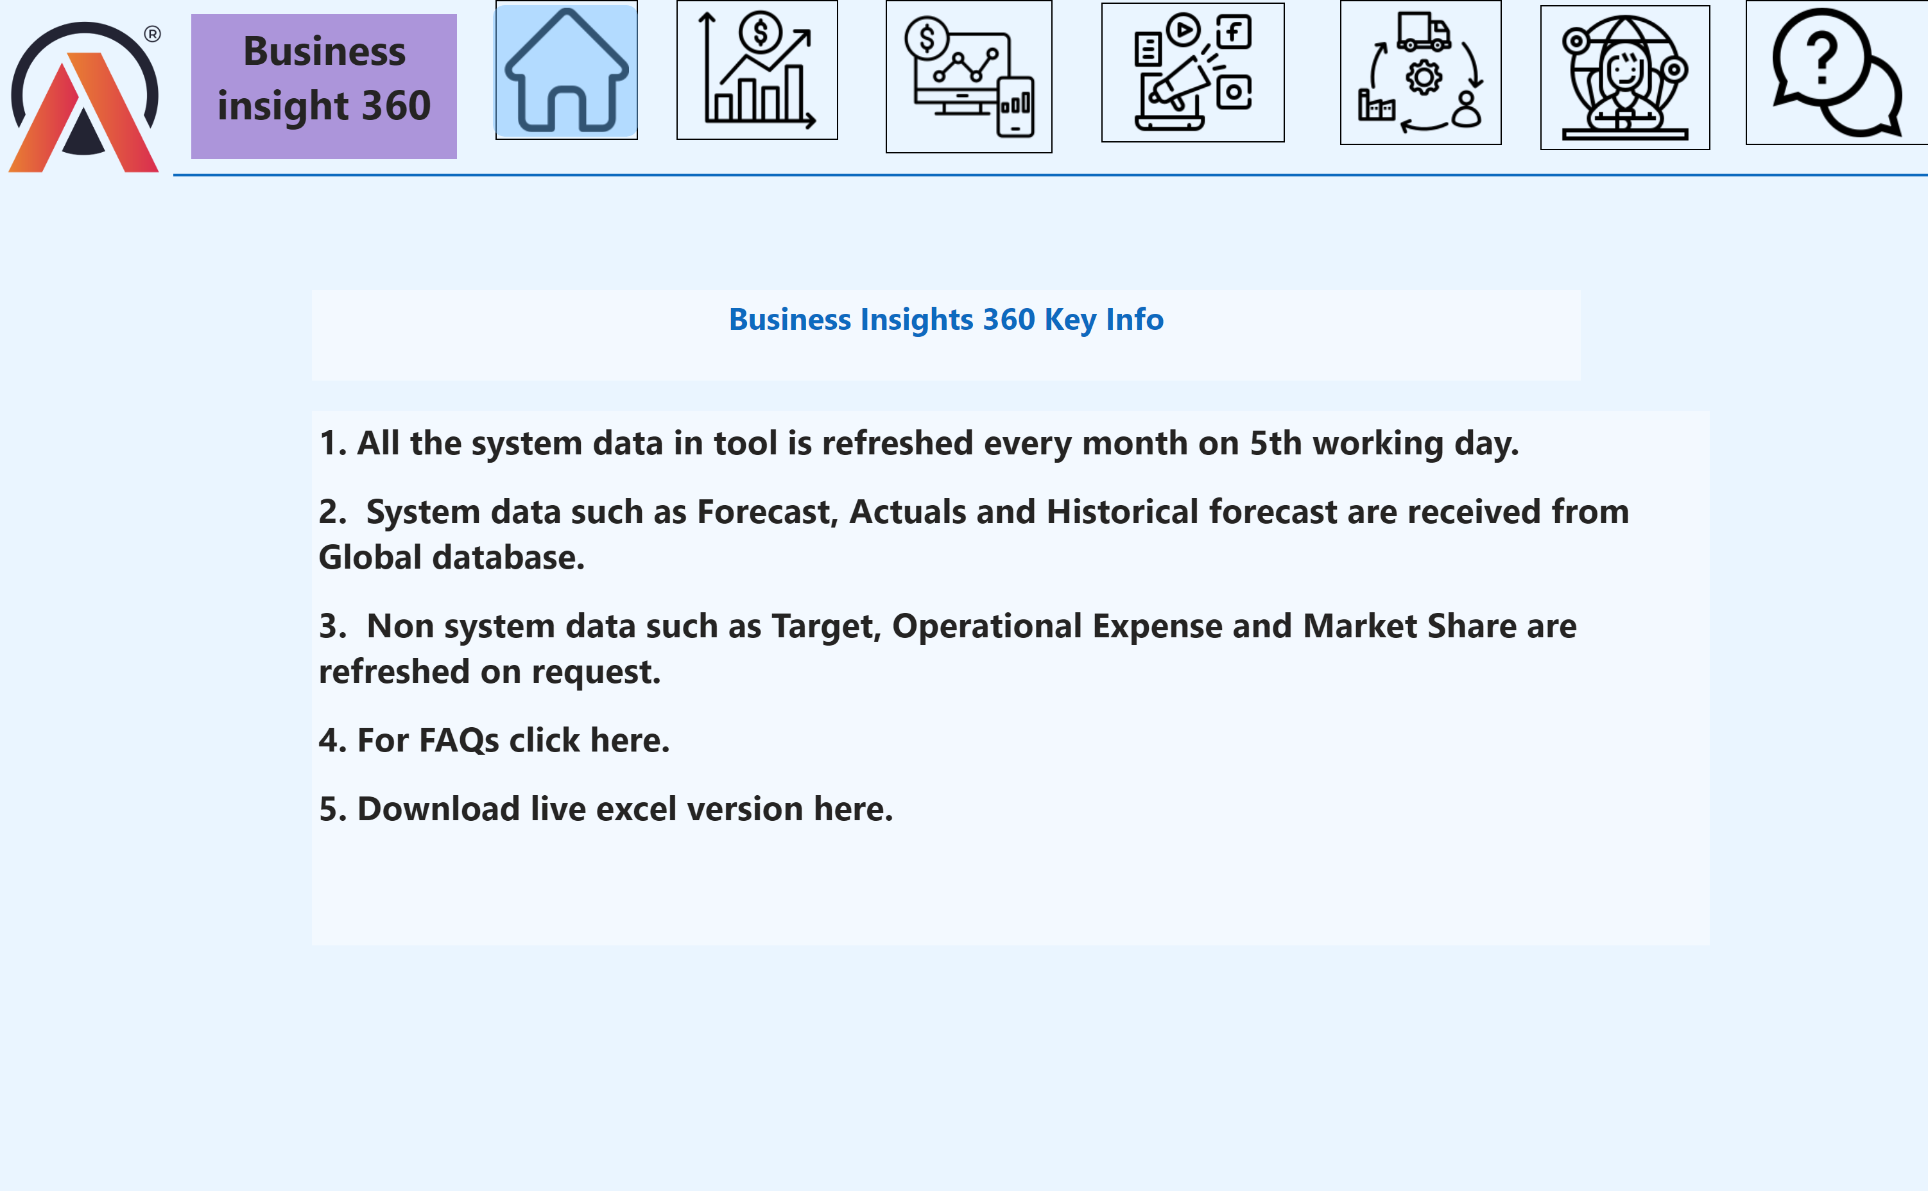
Info
Notes:
image
No alt text provided
image
No alt text provided
textbox
No alt text provided
image
No alt text provided
shape
No alt text provided
image
No alt text provided
image
No alt text provided
image
No alt text provided
image
No alt text provided
textbox
No alt text provided
textbox
No alt text provided
shape
No alt text provided
image
No alt text provided

Slide 4
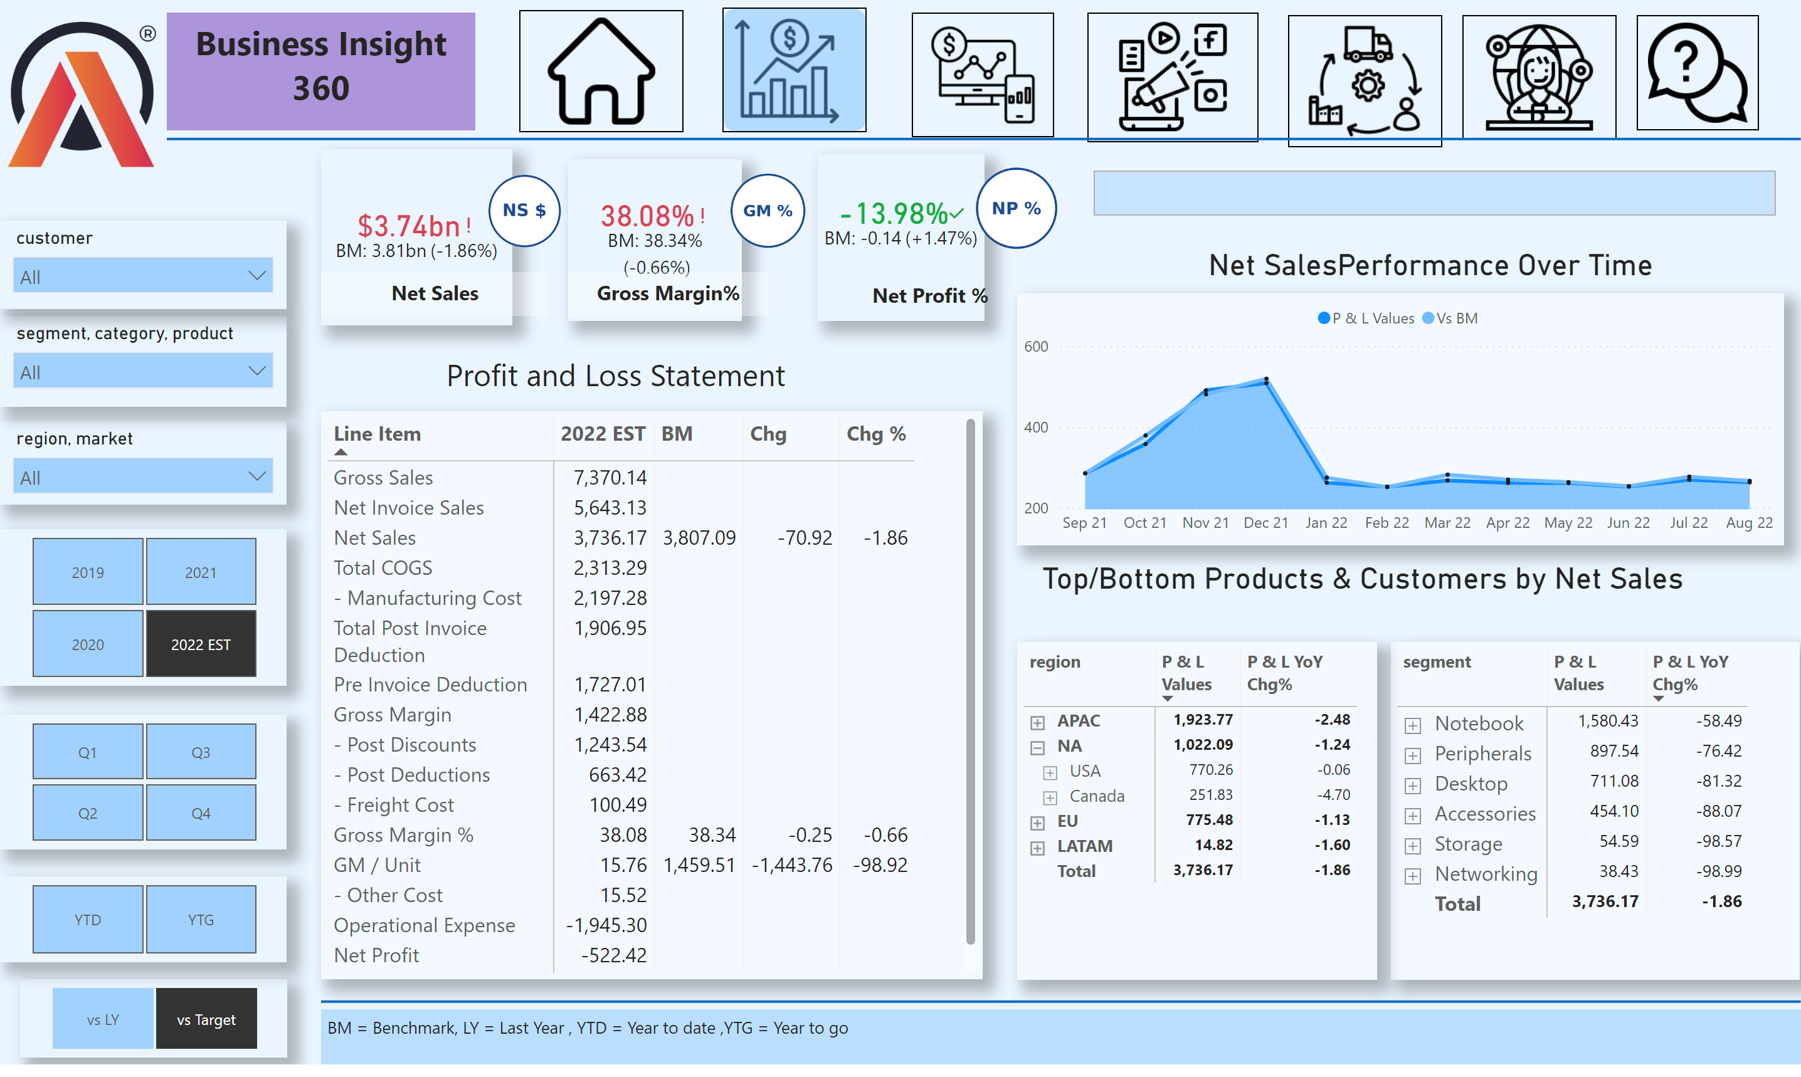
Finance View
Notes:
image
No alt text provided
shape
No alt text provided
image
No alt text provided
kpi
No alt text provided
slicer
No alt text provided
image
No alt text provided
textbox
No alt text provided
textbox
No alt text provided
slicer
No alt text provided
slicer
No alt text provided
pivotTable
No alt text provided
image
No alt text provided
shape
No alt text provided
Net SalesPerformance Over Time
No alt text provided
slicer
No alt text provided
slicer
No alt text provided
slicer
No alt text provided
textbox
No alt text provided
card
No alt text provided
image
No alt text provided
textbox
No alt text provided
card
No alt text provided
image
No alt text provided
image
No alt text provided
pivotTable
No alt text provided
cardVisual
No alt text provided
image
No alt text provided
shape
No alt text provided
textbox
No alt text provided
image
No alt text provided
image
No alt text provided
slicer
No alt text provided
pivotTable
No alt text provided
kpi
No alt text provided
image
No alt text provided
textbox
No alt text provided
kpi
No alt text provided

Slide 5
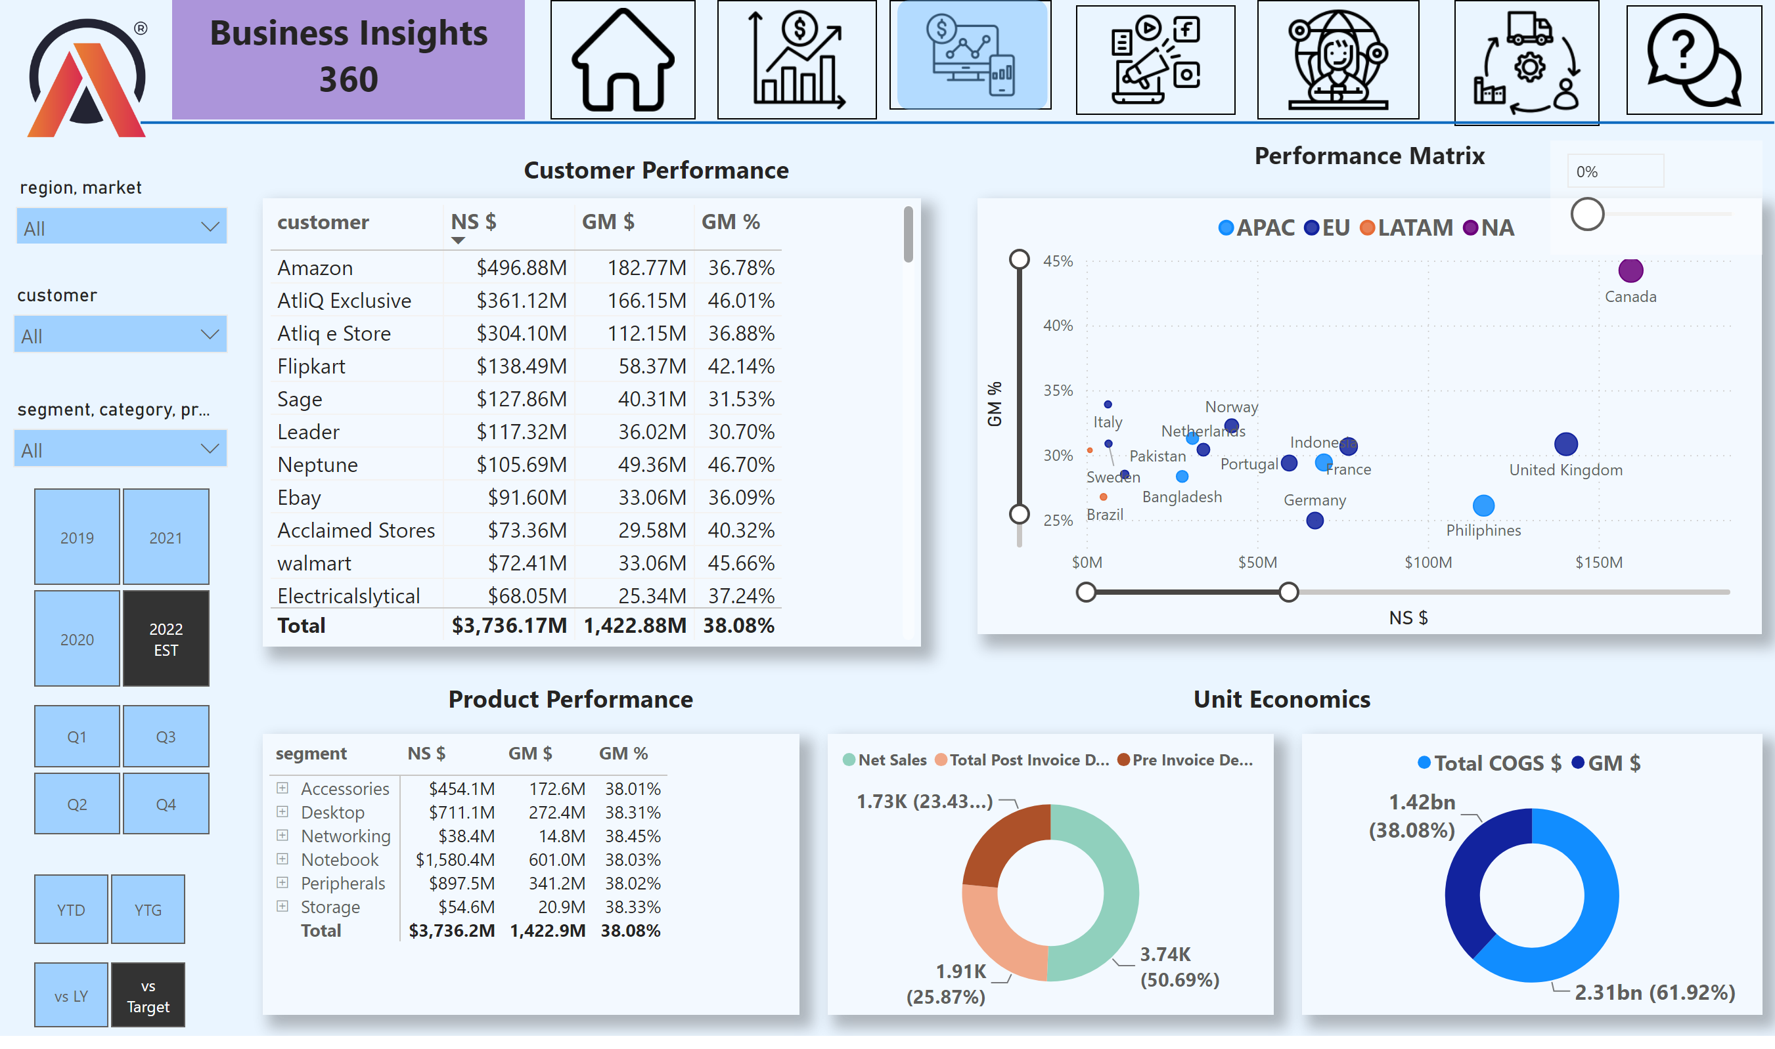
Sales view
Notes:
scatterChart
No alt text provided
slicer
No alt text provided
image
No alt text provided
image
No alt text provided
image
No alt text provided
slicer
No alt text provided
tableEx
No alt text provided
textbox
No alt text provided
shape
No alt text provided
image
No alt text provided
slicer
No alt text provided
slicer
No alt text provided
image
No alt text provided
textbox
No alt text provided
donutChart
No alt text provided
donutChart
No alt text provided
pivotTable
No alt text provided
image
No alt text provided
image
No alt text provided
image
No alt text provided
textbox
No alt text provided
shape
No alt text provided
slicer
No alt text provided
textbox
No alt text provided
textbox
No alt text provided
slicer
No alt text provided
slicer
No alt text provided
slicer
No alt text provided

Slide 6
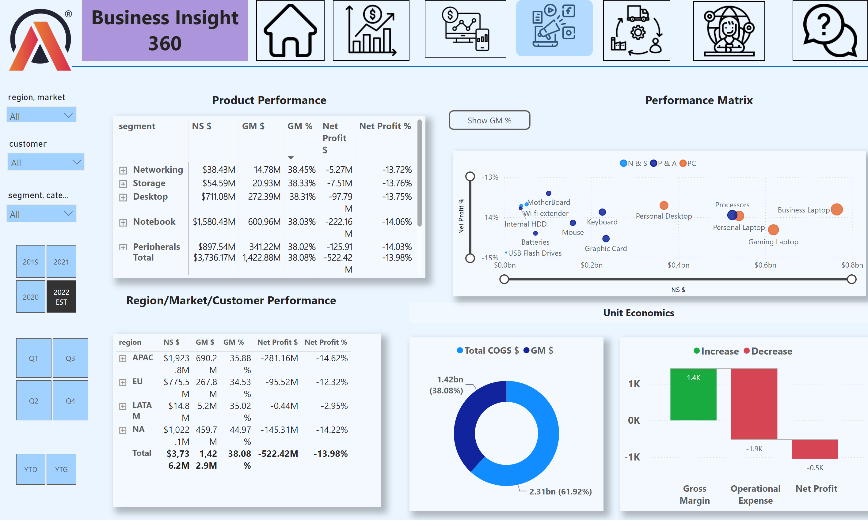
Marketing View
Notes:
slicer
No alt text provided
slicer
No alt text provided
image
No alt text provided
pivotTable
No alt text provided
textbox
No alt text provided
shape
No alt text provided
textbox
No alt text provided
image
No alt text provided
image
No alt text provided
image
No alt text provided
textbox
No alt text provided
donutChart
No alt text provided
waterfallChart
No alt text provided
GM % Button
No alt text provided
pivotTable
No alt text provided
slicer
No alt text provided
image
No alt text provided
image
No alt text provided
slicer
No alt text provided
image
No alt text provided
actionButton
No alt text provided
NP % Visual
No alt text provided
image
No alt text provided
textbox
No alt text provided
shape
No alt text provided
slicer
No alt text provided
textbox
No alt text provided
scatterChart
No alt text provided
slicer
No alt text provided

Slide 7
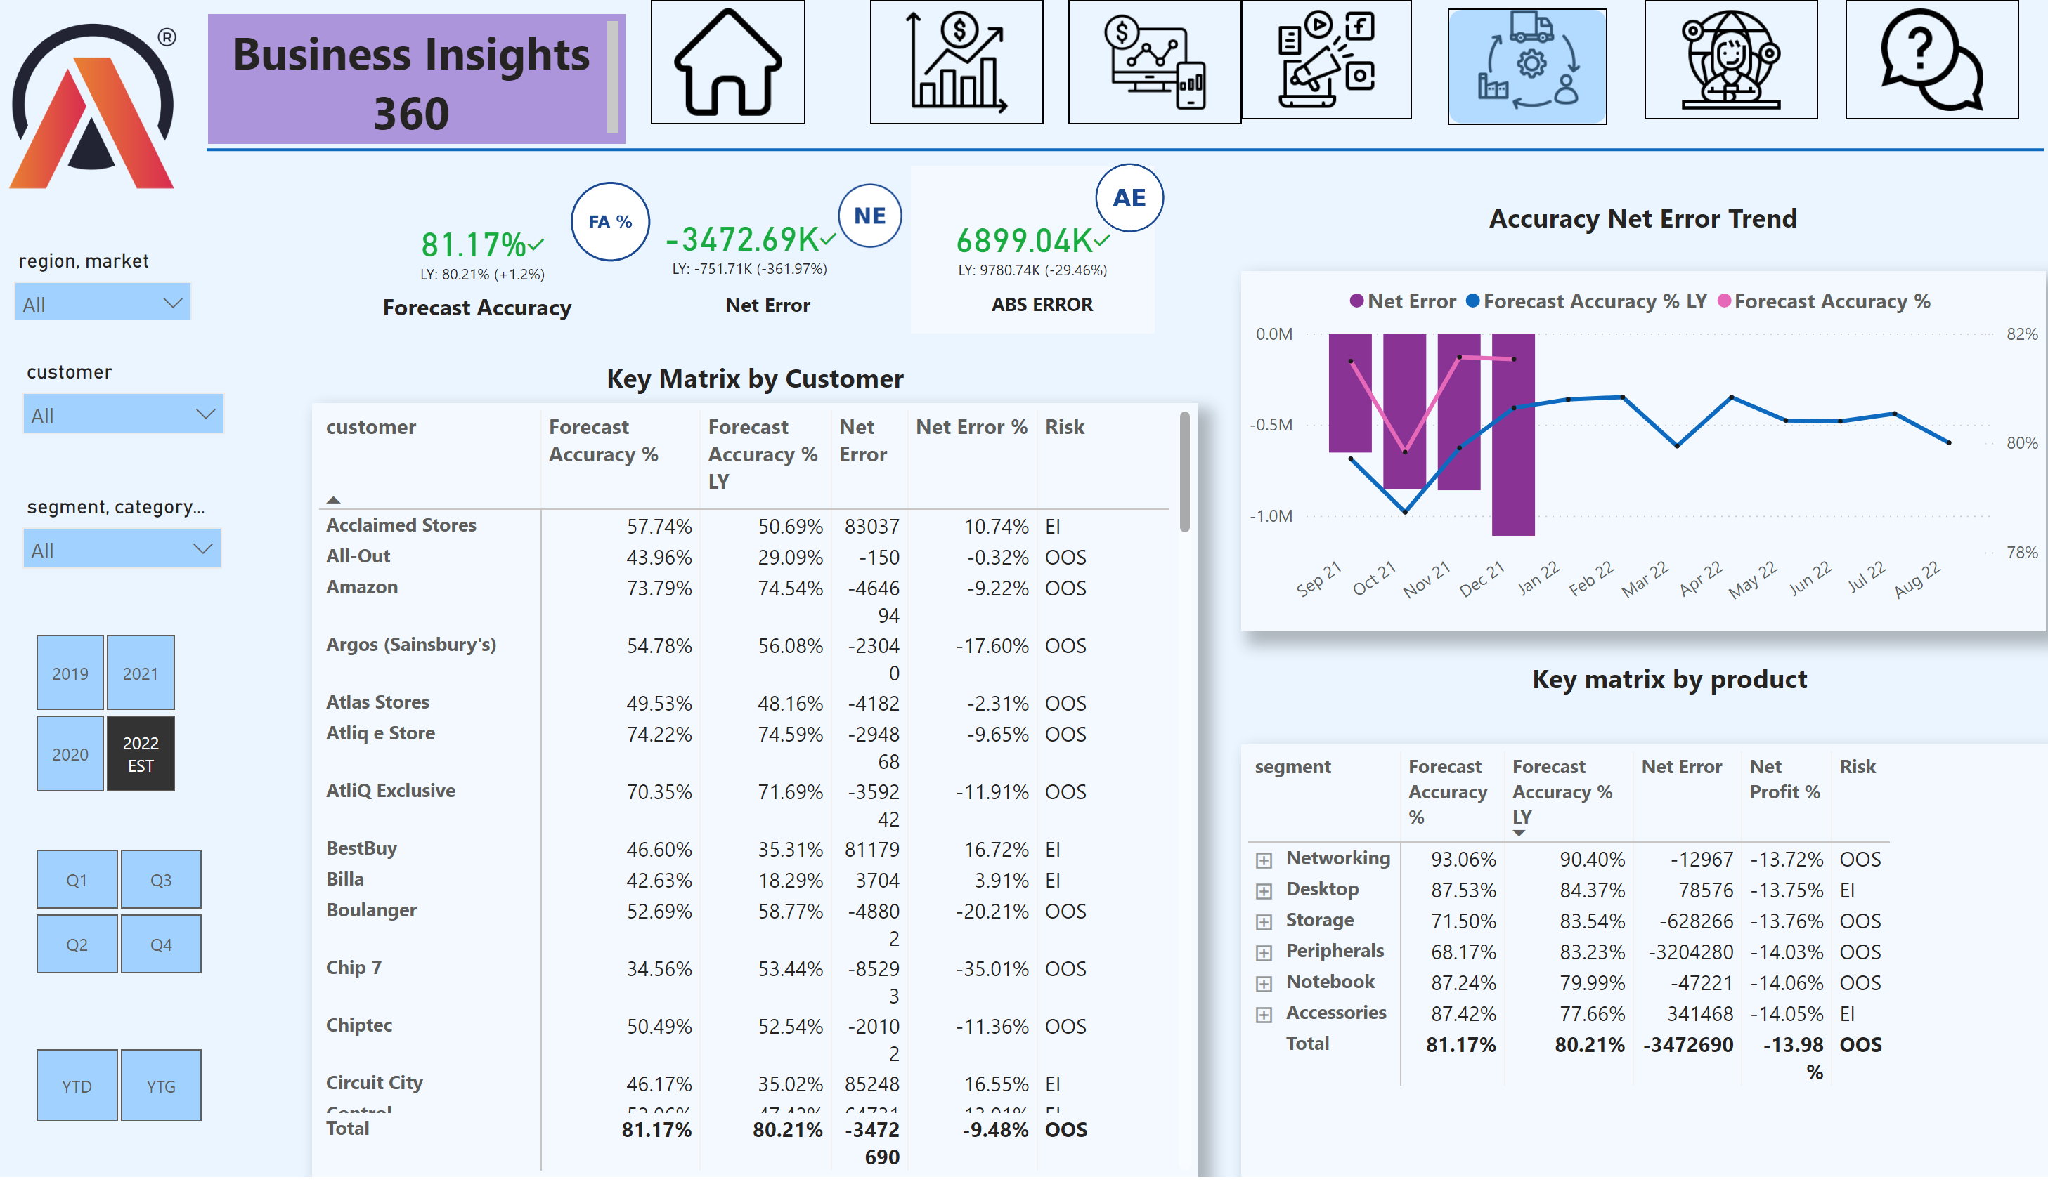
Supply Chain View
Notes:
pivotTable
No alt text provided
image
No alt text provided
kpi
No alt text provided
textbox
No alt text provided
slicer
No alt text provided
image
No alt text provided
slicer
No alt text provided
shape
No alt text provided
textbox
No alt text provided
image
No alt text provided
image
No alt text provided
slicer
No alt text provided
lineClusteredColumnComboChart
No alt text provided
textbox
No alt text provided
textbox
No alt text provided
textbox
No alt text provided
shape
No alt text provided
image
No alt text provided
image
No alt text provided
kpi
No alt text provided
textbox
No alt text provided
kpi
No alt text provided
image
No alt text provided
image
No alt text provided
slicer
No alt text provided
image
No alt text provided
image
No alt text provided
pivotTable
No alt text provided
slicer
No alt text provided
slicer
No alt text provided
image
No alt text provided
textbox
No alt text provided

Slide 8
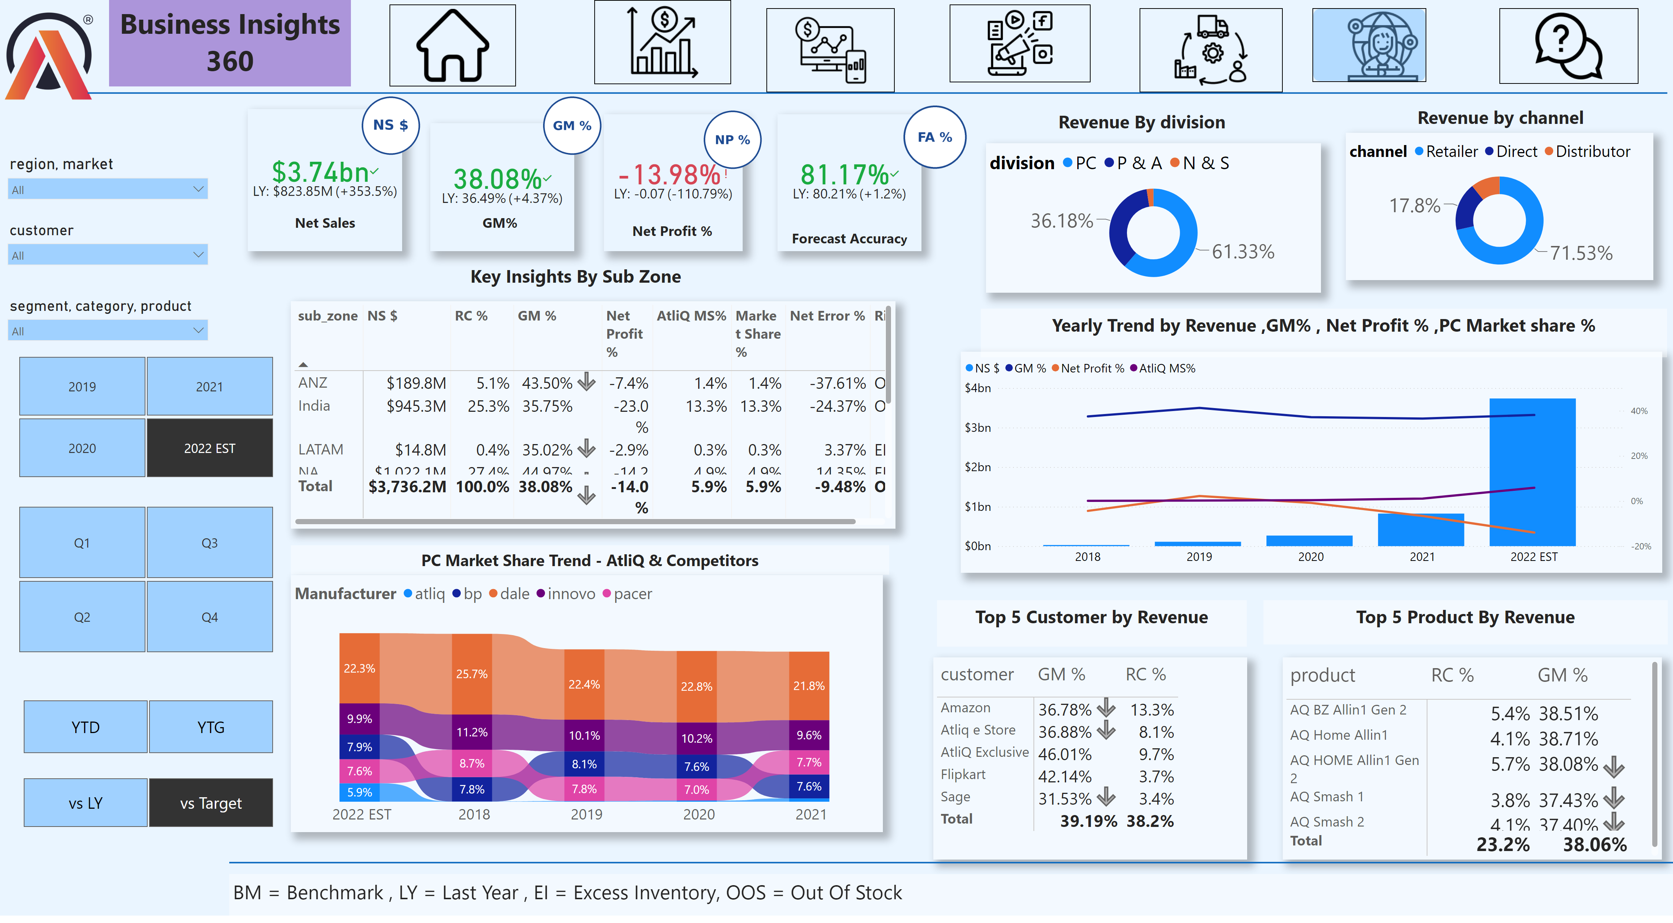
Executive View
Notes:
textbox
No alt text provided
image
No alt text provided
slicer
No alt text provided
image
No alt text provided
pivotTable
No alt text provided
ribbonChart
No alt text provided
image
No alt text provided
image
No alt text provided
donutChart
No alt text provided
image
No alt text provided
textbox
No alt text provided
kpi
No alt text provided
image
No alt text provided
slicer
No alt text provided
pivotTable
No alt text provided
slicer
No alt text provided
shape
No alt text provided
textbox
No alt text provided
slicer
No alt text provided
textbox
No alt text provided
donutChart
No alt text provided
textbox
No alt text provided
textbox
No alt text provided
shape
No alt text provided
image
No alt text provided
kpi
No alt text provided
textbox
No alt text provided
textbox
No alt text provided
slicer
No alt text provided
slicer
No alt text provided
pivotTable
No alt text provided
image
No alt text provided
image
No alt text provided
textbox
No alt text provided
textbox
No alt text provided
kpi
No alt text provided
textbox
No alt text provided
image
No alt text provided
image
No alt text provided
shape
No alt text provided
textbox
No alt text provided
kpi
No alt text provided
slicer
No alt text provided
image
No alt text provided
lineStackedColumnComboChart
No alt text provided
textbox
No alt text provided

Slide 9
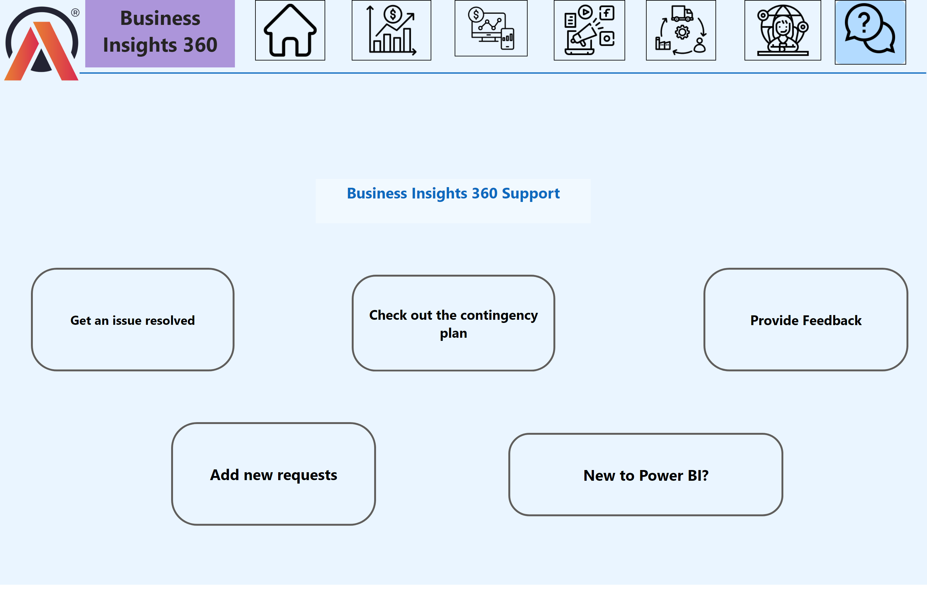
Support
Notes:
actionButton
No alt text provided
textbox
No alt text provided
shape
No alt text provided
actionButton
No alt text provided
image
No alt text provided
image
No alt text provided
image
No alt text provided
actionButton
No alt text provided
shape
No alt text provided
image
No alt text provided
textbox
No alt text provided
image
No alt text provided
actionButton
No alt text provided
image
No alt text provided
actionButton
No alt text provided
image
No alt text provided
image
No alt text provided

